Slide 1
Lariat Strategies to Increase Profit
Presented by Mel Fraser
Notes:
Welcome Lariat executives. My name is Mel Fraser and I will be presenting to you my analysis on how to increase profit for Lariat Car Rentals.

Slide 2

3 Strategies Identified
Immediate
Effective
Cumulative
Notes:
I was given Data covering costs and profits of the car fleets and the locations of the rental agencies. I was looking for ways to increase profit that were easy, effective, immediate, and cumulative.
I was able to come up with 3 different strategies that can build off of one another for a combined master strategy that will increase net revenue.

Slide 3
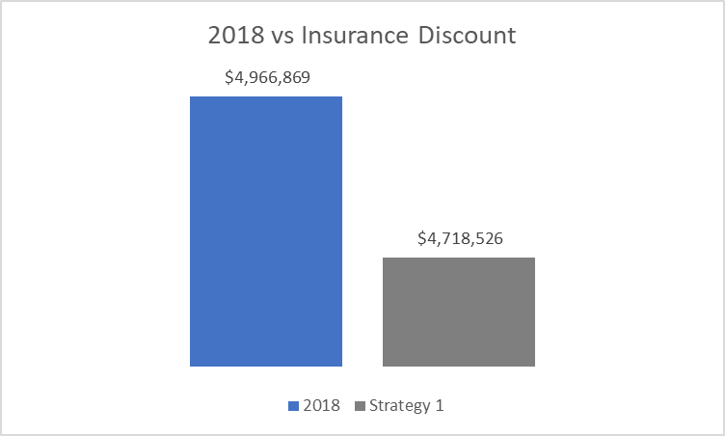
Insurance Loyalty Discount (5%)
Notes:
I first evaluated the costs and quickly thought of a potential plan with insurance. As anyone who drives a car knows, there are frequent discounts and bundles that can be made with insurance companies. I took the initiative to reach out to the Insurance Liaison team to see if this was something we could negotiate with Lariat’s insurers. The team was able to get a quote for a loyalty discount, as we already had the rental and corporation discounts applied. This discount is for 5% off of our total annual insurance cost of 4,966,869. Our new total, should Lariat accept the quote, will be for 200 thousand less at 4,718,526.

Slide 4
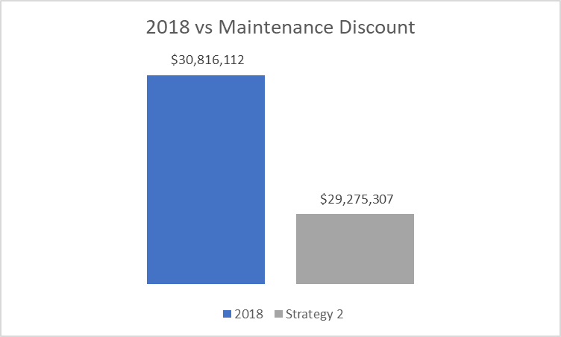
Maintenance Plan Discount (5%)
Notes:
The second area of attention came naturally after that. Discount in maintenance costs. First, I made sure the main provider of maintenance for Lariat fleet vehicles was available in every state there was a Lariat Rental Agency. That being confirmed I spoke to the team that helps schedule maintenance and repairs. We were able to negotiate another 5% discount if we set up pre-scheduled maintenance plans for the entire fleet. This will also save on time and help with scheduling the rentals. If we know in advanced when each rental vehicle will be in the shop getting oil changes, tire rotations, etc, then it will offer a smoother rental schedule.
This discount saves Lariat about 1.5 million annually.

Slide 5
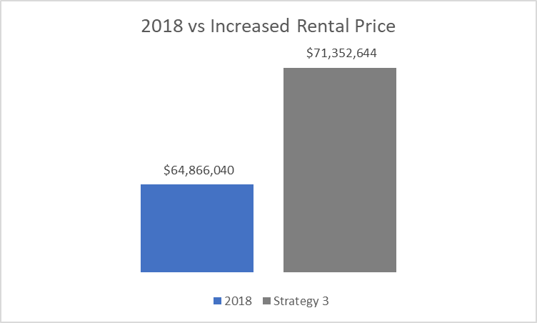
Increase Daily Rental Prices (10%)
Notes:
The final area of interest is price per day of vehicle rentals. As each vehicle and trip has their own price, I went ahead and averaged the cost to 162 dollars a day. I realized when aggregating the data, that majority of customers are in their 40s. This two me says two things: they are likely established in their careers and stable in finances, and many are probably using them for work trips. This being the case, I believe they will be able to afford and tolerate a price increase. By increasing the average cost of rentals by a mere 10%, we are able to increase the revenue 6.5 million dollars. This is a typical increase in the industry and still keeps Lariat competitive with other rental companies at an average rental price of $178 a day.

Slide 6
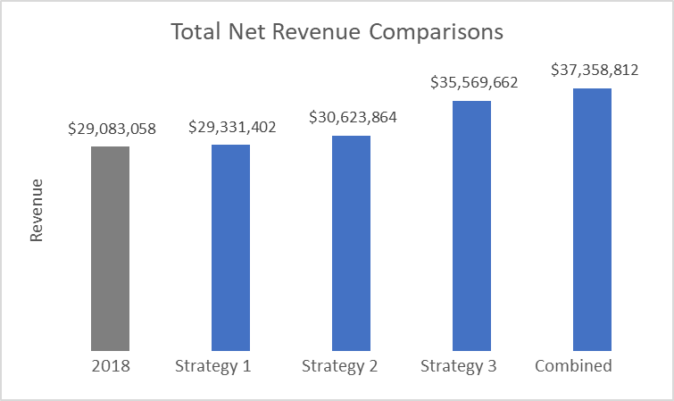
Combined Strategies
Notes:
As I mentioned at the beginning, each of these strategies are easy to implement, will have immediate effects, and can be cumulative. In my excel model, which you will get a copy of after the presentation, I created a strategy that combines the above three areas of revenue increase. Lowering maintenance and insurance costs by 5%, and increasing rental prices by 10%. This raises Lariat’s net revenue from 29million to 37.4 million dollars. With an over 8 million dollar increase in revenue, this is the strategy I recommend Lariat pursue for the next financial year.

Slide 7

Marketing Ideas
Younger Demographics
Gender Inclusive
Notes:
While analyzing the data, I did notice a few points of interest for marketing strategies that I would like to share with Lariat.
We can further monetize this insight by reaching out to companies in the areas of our major hubs in Texas and California, and contracting agreements with them. If their employees utilize our services, they will get the pre-increase rental cost, and we will secure consistent revenue.
Other areas of interest to pass onto your marketing team, is that there is an even split between male and female customers. Lariat should focus on gender inclusive and gender-neutral advertising.
The need to appeal to younger demographics, as majority of Lariat’s customers are in their 40s.

Slide 8


Insights
Purpose of rental?
Single or group travel?
Destinations?
Notes:
Finally, in the future, for more in depth analysis and new strategies, I would like to see data on how many passengers are intended for each vehicle – is it for a single driver? Couples? Or families? A way to survey the customers to see what is the reason behind their rental – business, vacation, road trip, etc – per vehicle. And if the destinations are in state or out of state per vehicle. These insights would allow Lariat to see which types of vehicles to invest in for the future.

Slide 9
Thank you!

